Slide 1
Beer Ratings Analysis & Prediction
MSDS 6306 Case study 2
Bhuvana Adur Kannan
Christopher Ballenger
Selwyn Samuel

Slide 2
Outline
Project Goals
Data Gathering
Feature Selection
Modeling
Results

Slide 3
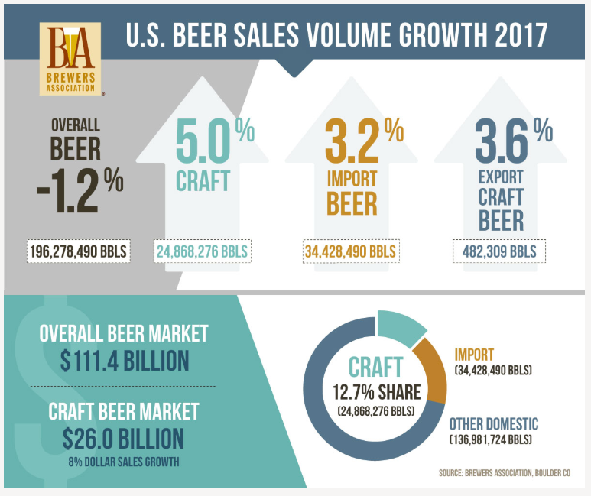
Beer Industry
Trend
Overall beer sales down 1%
Craft & Import beer sales up 8%
23% of overall beer sales
Beer drinkers are turning into beer enthusiasts & beer connoisseurs
“For me, it equates to a sense of adventure – collecting sensory experiences through flavor profiles like Indiana Jones collects priceless artifacts. The excitement of a satisfying brew, falling into off-flavors – these experiences belong in the museum of your mind!”
- Katy Tilley (DESTIHL Brewery Ambassador)
Source: https://www.brewersassociation.org

Slide 4
Questions
Is there a bias in the way beer enthusiasts rate a beer at a brewery location and other locations?
Can we predict an introductory market or area where a beer will be successful?
When a beer enthusiast/connoisseur walks into a brewery can we recommend a beer that he/she would like based on their past ratings profile?

Slide 5
Project Goals
Data Science Project Life Cycle
Reproducible research
Apply Statistics lessons from MSDS 6371
Problem analysis & Identification of tests
Learn new technologies
APIs, Web Scraping, ML algorithms, H₂O Platform
Learn the model and not Perfect the model
Run evaluations on the model
Report statistics on the model

Slide 6
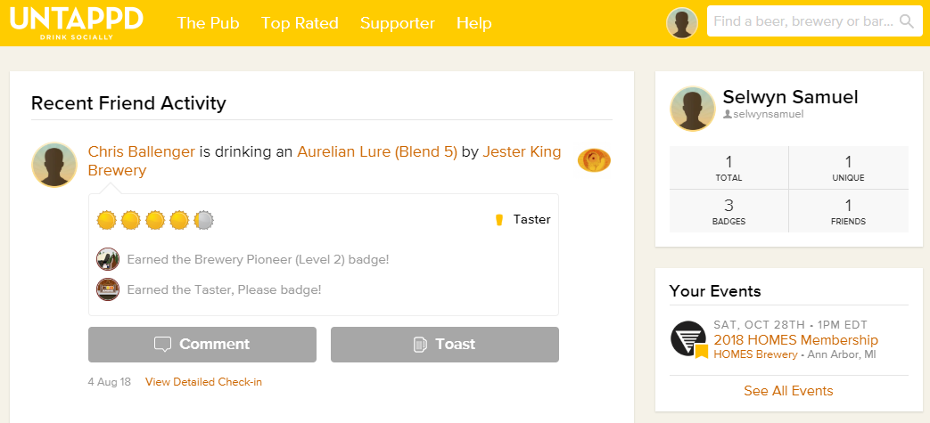


Data Gathering
R Code to get JSON Objects
5 Users, 300+ check-ins, 1500 observations
1100 beer details
rvest & Rselenium packages, CSS Selector
Tricky “show more” logic
HTML parse -> data frame -> CSV files
API
Web Scraping
Long API Client approval process
100 Calls per hour restriction
IP Black-listed – Intelligent Proxies
Throttle http calls

Slide 7
Breweries we targeted

Slide 8
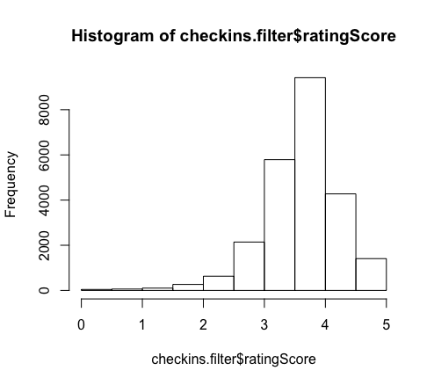
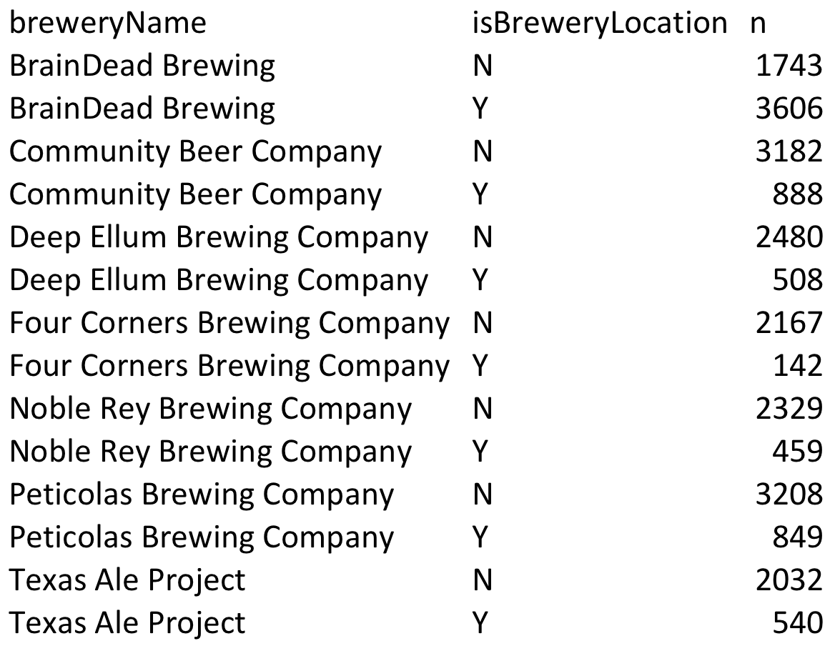
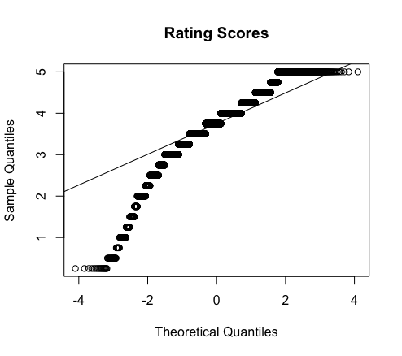
Bias in how we rate beers - Assumptions
The does not appear to come from a normal distribution, however given its large sample size CLT will be robust from violations.

Slide 9
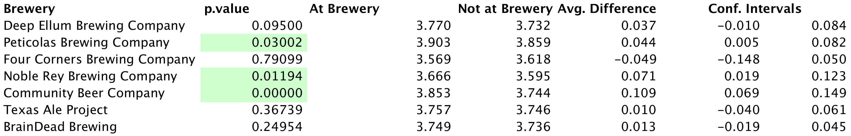
Conclusion
At a significant level of .05, Peticolas, Nobel Rey, and Community mean rating is greater while consumed at the brewery versus not at the brewery. A 95% confident intervals are listed above.
This was an observational study thus no inference can be inferred from the study. The data was consumed from one week worth of 300 check-ins per beer and not a random sample. We can only inferred the outcome from this population.
Full test can be found on our github repository: LocationBias.Rmd

Slide 10
Where are people checking in beers?

